Slide 1
A Scalable Deep Learning Approach for Identifying AI-Generated Content in User Reviews
Names:
Venkata Krishna Reddy Modem
Mahesh Ram Gunturu
Pavan Kumar Chinthaginjala

Slide 2
Problem Background
Rise of AI-generated content through LLMs (e.g., ChatGPT, Gemini, Claude) threatens the authenticity of online reviews.
Businesses can be misled by synthetic reviews—impacting decisions and trust.
Manual detection is inefficient and unreliable.
Need for a robust, automated detection system.

Slide 3
Research Aim & Objectives
Aim: To develop a deep learning model to accurately detect LLM-generated online reviews.
Objectives:
Use dataset with real vs. LLM-generated reviews.
Design and train a CNN + Bi-GRU hybrid model.
Compare performance with baseline models (e.g., SVM, Random forest, Gru, LSTM).
Evaluate detection robustness across topics and LLM types.

Slide 4
Literature Review Highlights
Stylometry & N-grams: Early methods; low accuracy and poor generalization.
Transformer models (e.g., RoBERTa): High accuracy but computationally expensive.
CNNs: Capture local patterns (e.g., repeated phrases) with low overhead.
BiGRUs: Efficiently capture global context with fewer parameters than LSTMs.
CNN + BiGRU: A lightweight hybrid combining speed and sequence understanding—ideal for fast, real-time detection.

Slide 5
Proposed Methodology
Dataset: Combination of real online reviews and LLM-generated reviews from LLMs.
Model Architecture:
CNN layer: Extracts n-gram-like features.
Bi-GRU layer: Captures bidirectional dependencies.
Dense layer + Softmax: Final binary classification (real vs LLM-generated).
Preprocessing: Tokenization, padding, lowercasing.

Slide 6
Tools & Technologies
Programming Language: Python
Frameworks: TensorFlow / Keras
Libraries: NLTK, Scikit-learn, NumPy, Matplotlib
Dataset Sources: https://osf.io/tyue9/
Evaluation Metrics: Accuracy, Precision, Recall, F1-score

Slide 7
Evaluation Metrics
Metrics Used:
Accuracy: Percentage of correct predictions.
Precision: How many predicted LLM reviews were actually fake.
Recall: How many actual fake reviews were detected.
F1-Score: Balance between precision and recall.
Confusion Matrix: Visual summary of correct/incorrect predictions.

Slide 8
Methodology
Dataset Loading & Cleaning
Real and AI-generated Removed duplicates, punctuation, stopwords
Preprocessing
Tokenization, lemmatization, lowercasing
Truncated text to 900 characters
Vectorization
TF-IDF for ML models, tokenizer + padding for DL models
Model Training
Logistic Regression, XGBoost, LightGBM
LSTM, GRU, CNN + Bi-GRU

Slide 9
Models
Logistic Regression: A simple linear classifier used as a baseline for detecting text patterns.
XGBoost: A powerful gradient boosting method that captures feature importance well.
LightGBM: Fast and scalable boosting framework, good for structured text features.
LSTM: Long Short-Term Memory network captures long-range dependencies in sequential data.
Bi-GRU: Bi directional Gated Recurrent Unit is similar to LSTM but more efficient and faster to train.
CNN + Bi-GRU: A hybrid model that captures both local word patterns and bidirectional context.

Slide 10
Results
Model | Accuracy | Precision | Recall | F1-Score
XGBoost | 0.83 | 0.84 | 0.81 | 0.83
Logistic Regression | 0.83 | 0.83 | 0.84 | 0.83
LightGBM | 0.83 | 0.84 | 0.83 | 0.83
LSTM | 0.88 | 0.90 | 0.85 | 0.87
GRU | 0.88 | 0.87 | 0.90 | 0.89
CNN + Bi-GRU | 0.90 | 0.90 | 0.91 | 0.90
Model Performance Comparison As shown in the table, deep learning models—especially CNN + Bi-GRU—achieved significantly higher scores across all evaluation metrics. This highlights their superior ability to model textual and contextual patterns in review data compared to traditional machine learning approaches.

Slide 11
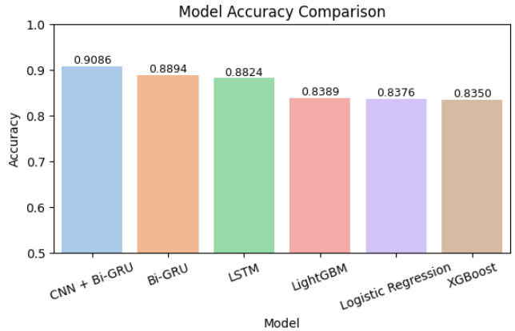
Conclusion
CNN + Bi-GRU achieved the best accuracy and generalization.
A high-performing deep learning model for LLM-generated text detection.
Benchmark results comparing hybrid vs traditional and transformer models.
Contribution to AI safety and digital content authenticity.
Developed a lightweight hybrid deep learning model that detects fake reviews effectively.

Slide 12
THANK YOU

